Slide 3
Our History

Slide 4
Global Footprint - Operations

Slide 5
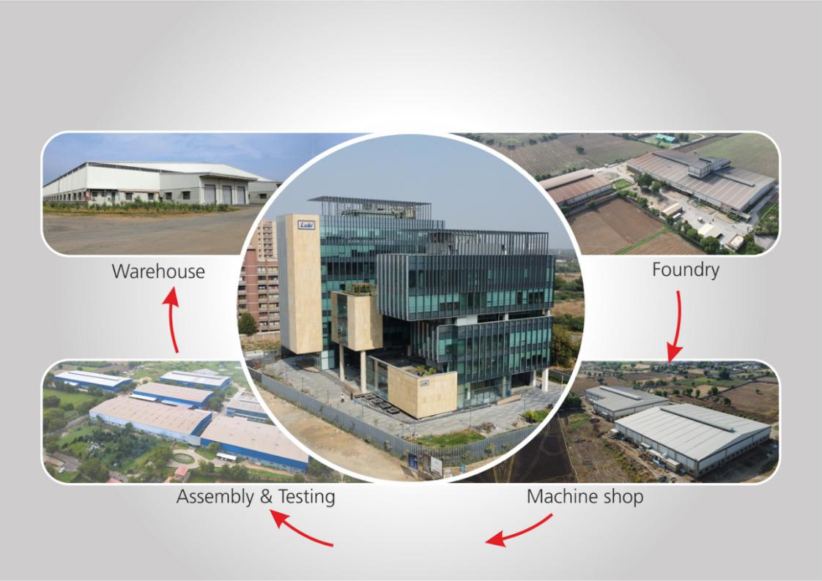
Ahmedabad - Operations

Slide 6
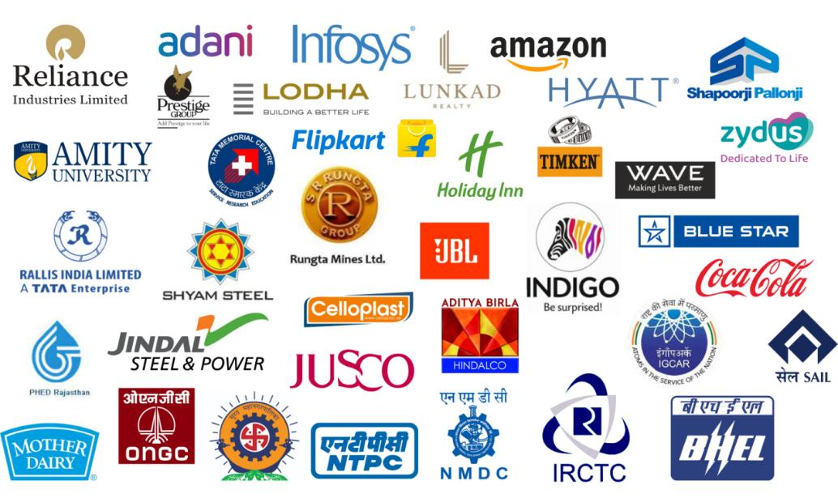
Esteemed Customers

Slide 7
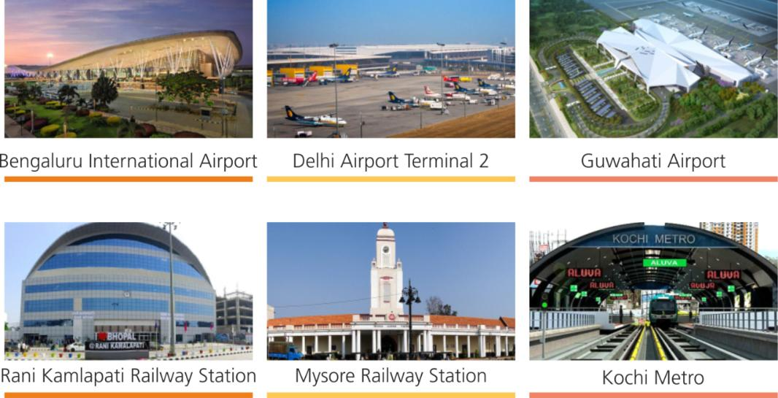
Prestigious Installations - Pumping System

Slide 8
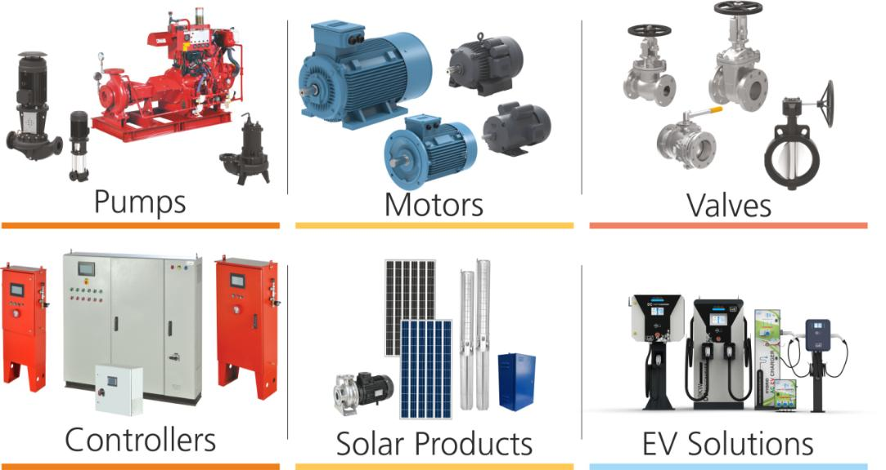
Our Product Verticals

Slide 9
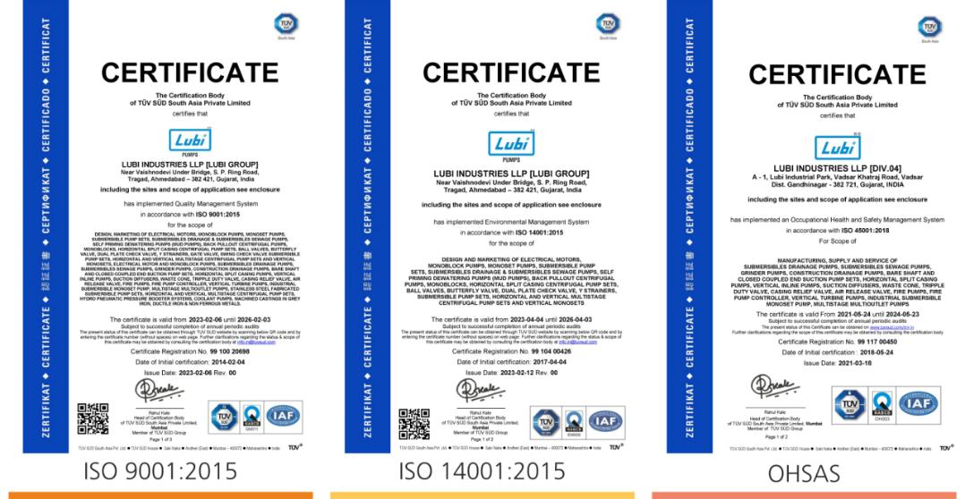
ISO Certificates

Slide 10
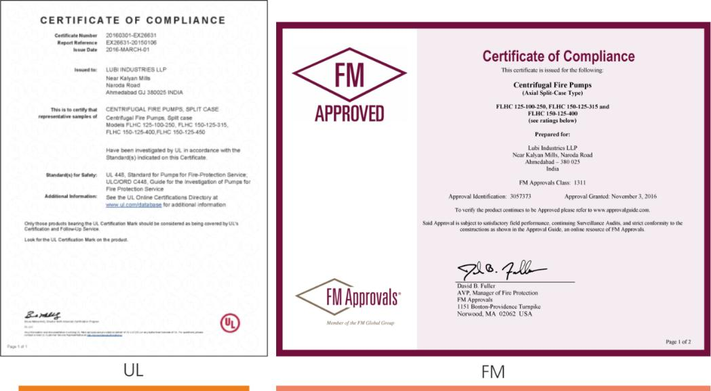
UL & FM Certificates for Fire Pumps

Slide 11
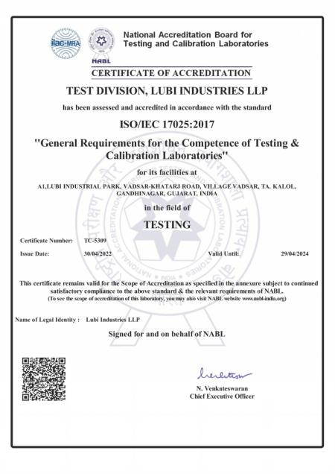
NABL Accrediated Laboratory Certificates

Slide 12
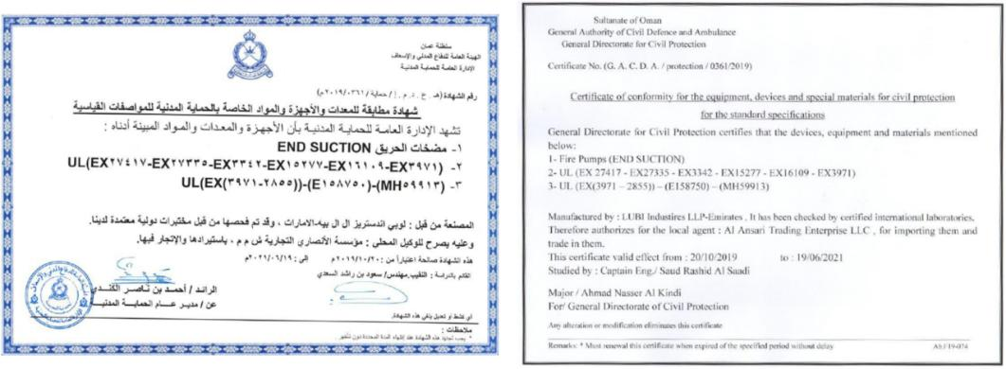
Oman Civil Defense Approvals

Slide 13
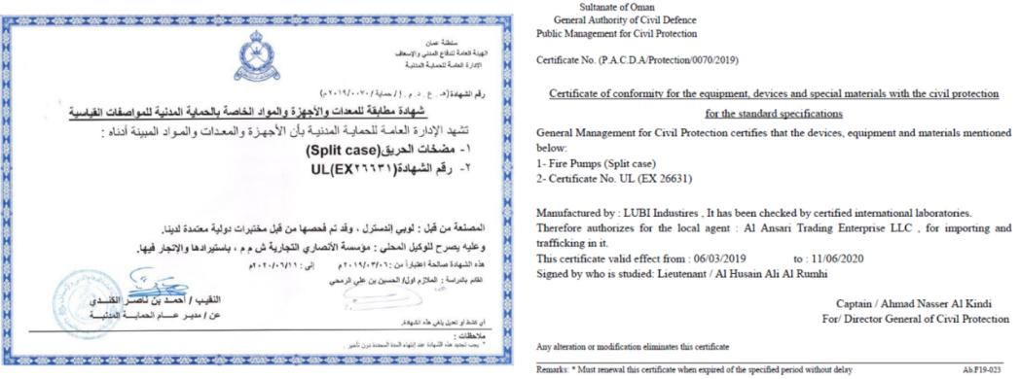
Oman Civil Defense Approvals

Slide 14
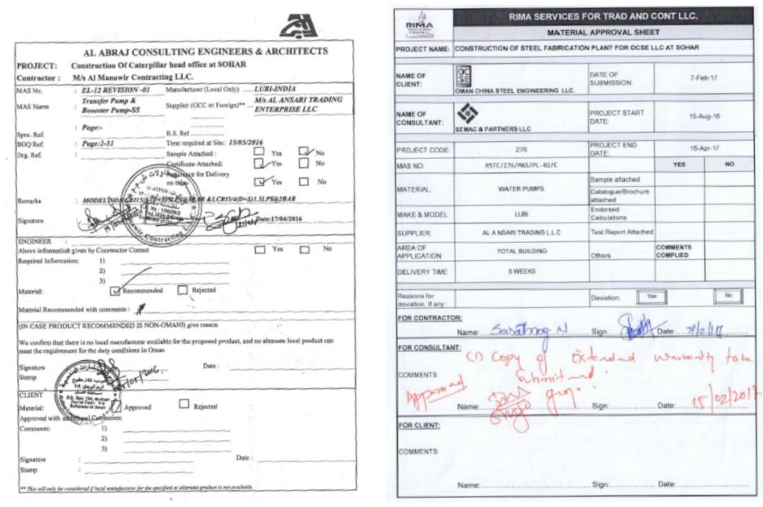
International Product approvals

Slide 15
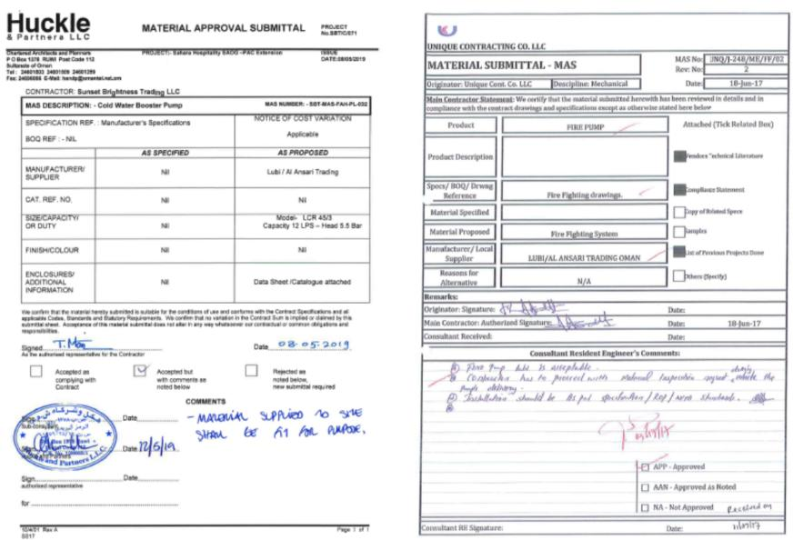
International Product approvals

Slide 16
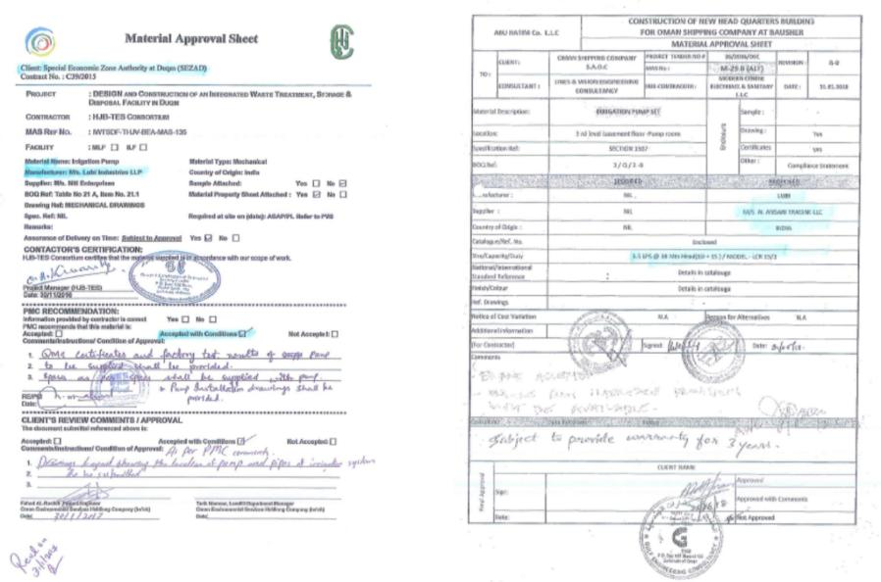
International Product approvals

Slide 17
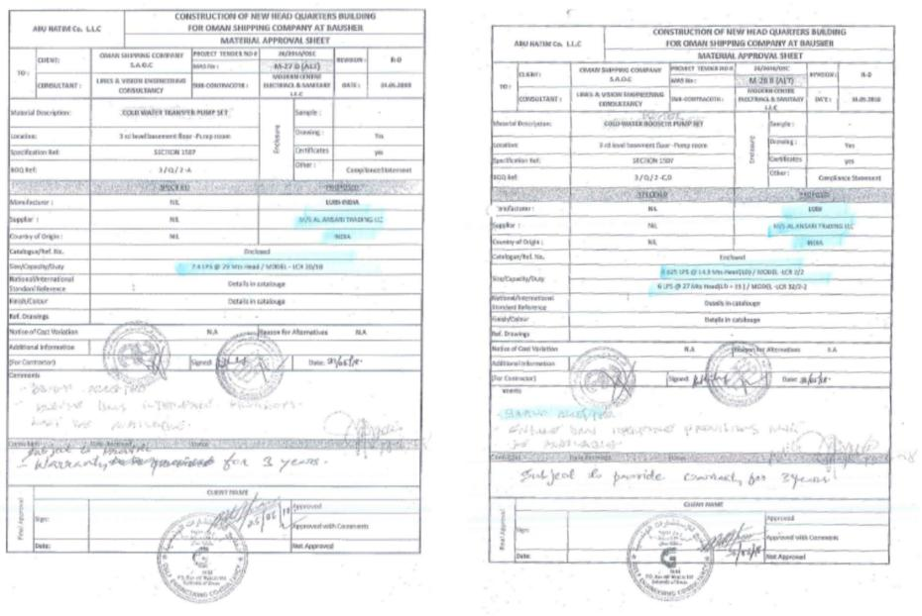
International Product approvals

Slide 18
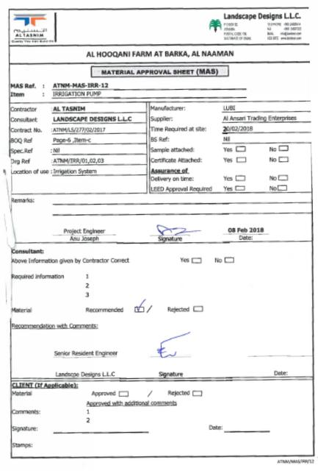
International Product approvals

Slide 19
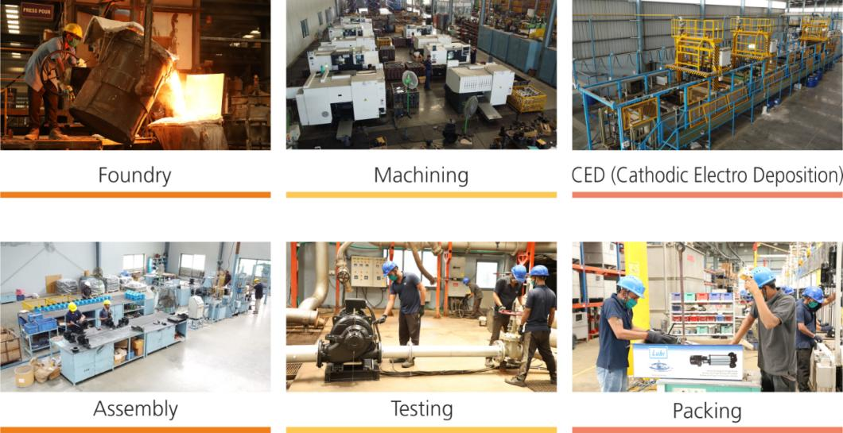
Manufacturing facilities

Slide 20
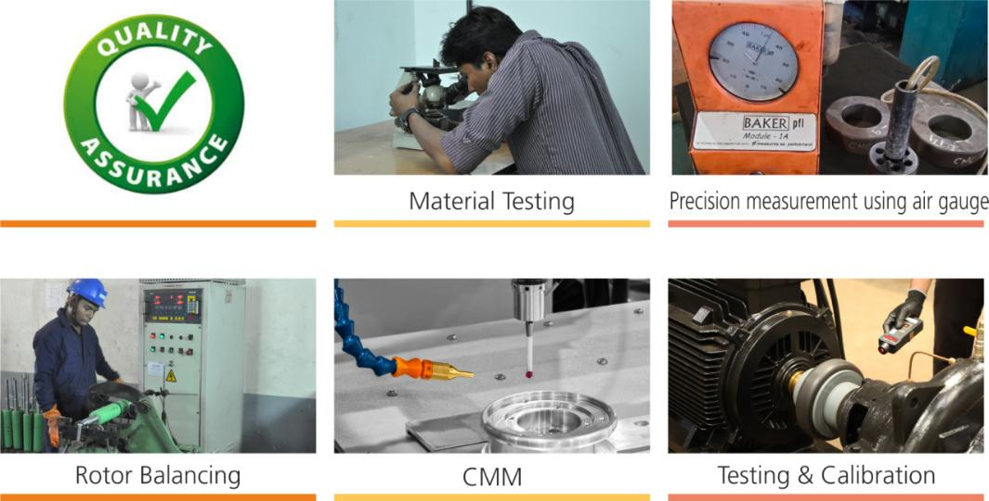
Quality Assurance Systems

Slide 21
Marketing Network PAN India

Slide 22
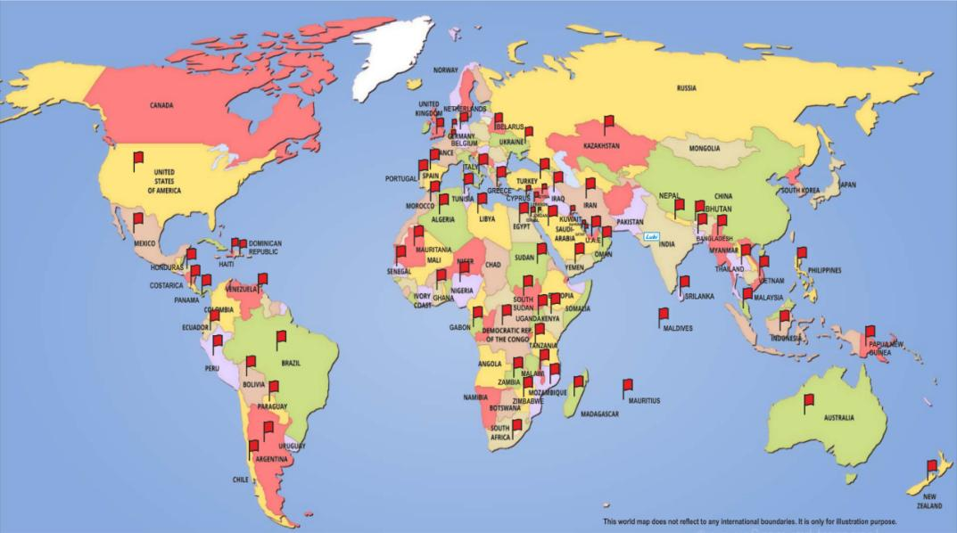
Global Presence in more than 80 Countries.

Slide 23
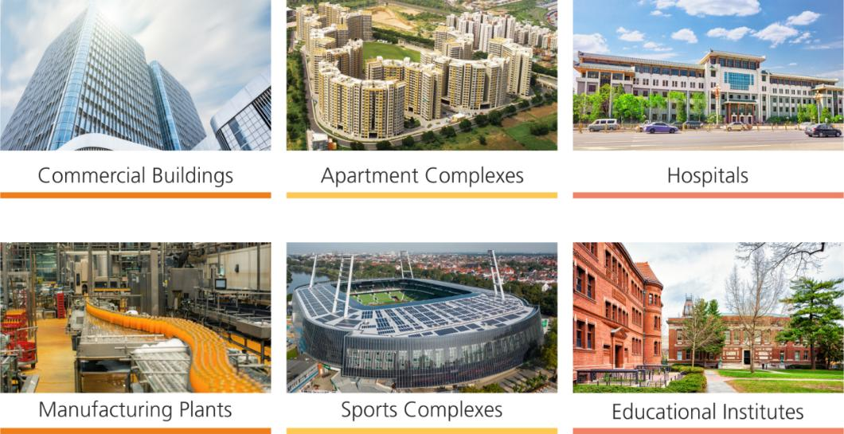
Applications

Slide 24
Product Range

Slide 25
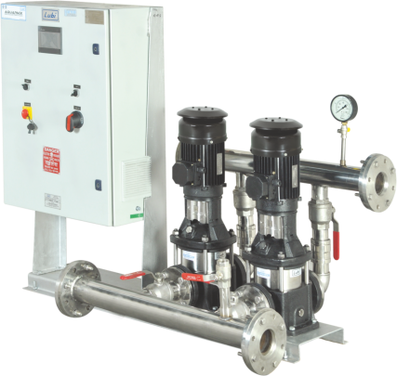
HPN Systems
• Well suited for constant pressure applications.
• Lubi booster sets consist of 2 to 4 identical Vertical Multistage
Pumps or End Suction Pumps mounted in parallel on a
common base frame, control cabinet with motor protection
and controller.
• Energy saving through cascade control of pumps as per
demand.
• Provision of stand-by pump for higher reliablity.
• Factory assembled and tested.
Application :
• Water Supply
• Flats / Apartments Complexes
• Hotels
• Hospitals
• Bungalows
• Car Washing
• Landscape Irrigation
• Industries etc.

Slide 26
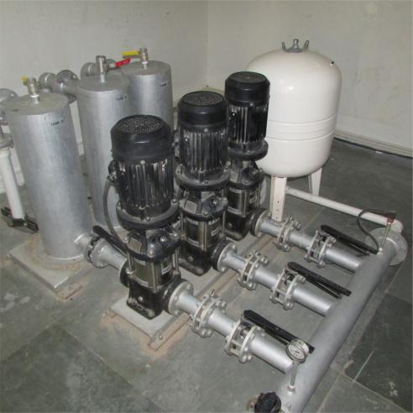
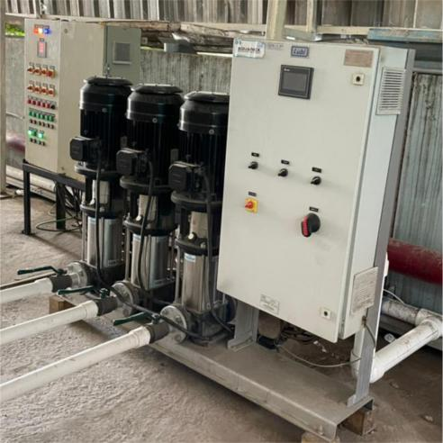
HPN Installations

Slide 27
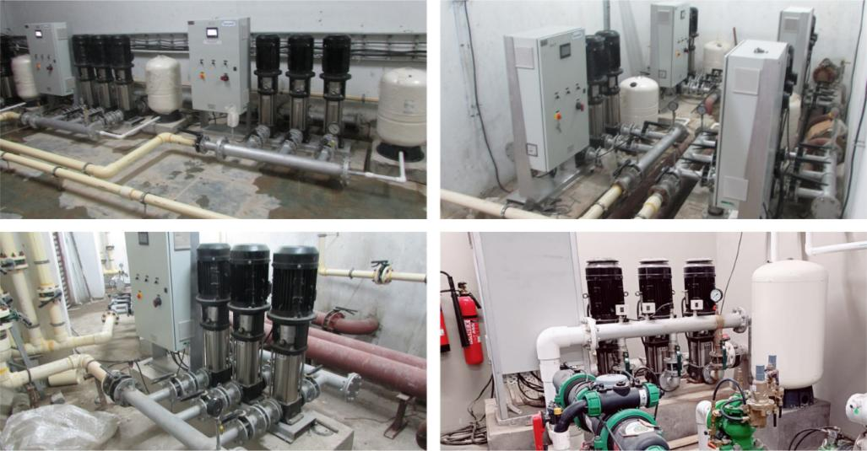
HPN Installations

Slide 28
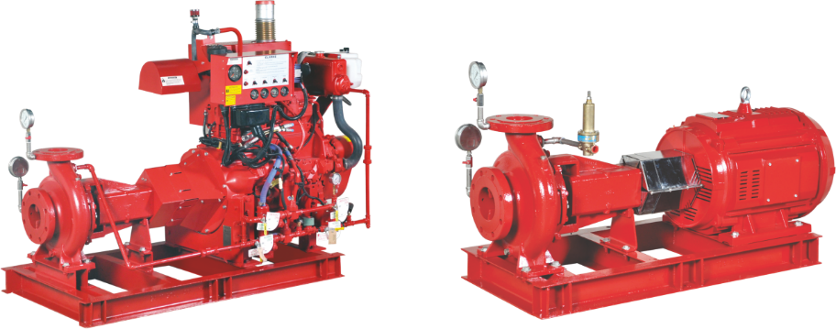
End-Suction Fire Pumps
Technical Data
• Flow Range : 190 lpm. to 4730 lpm.
• Pressure Range :54 mtr. to 210 mtr.
• Diesel Engine & Electric Motor driven
• UL Listed, FM Approved, NFPA-20 design
• Factory Assembled & Factory tested

Slide 29
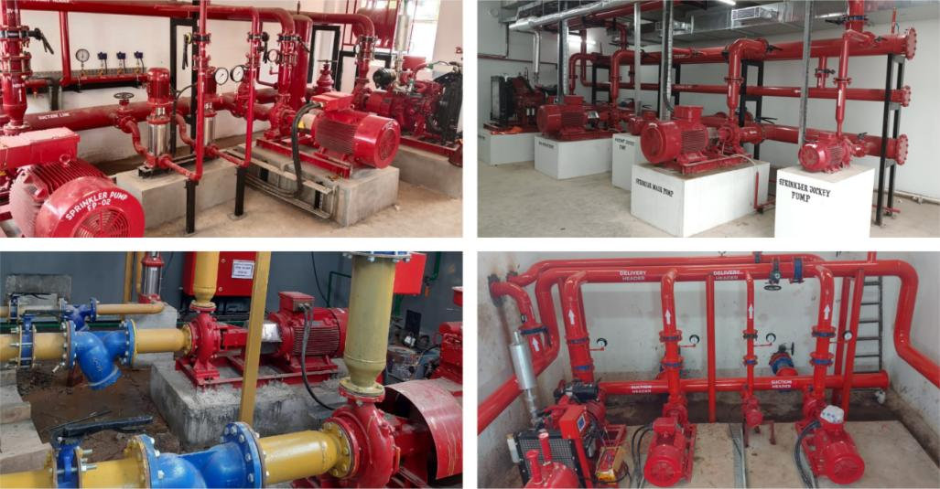
End-Suction Fire Pumps Installations

Slide 30
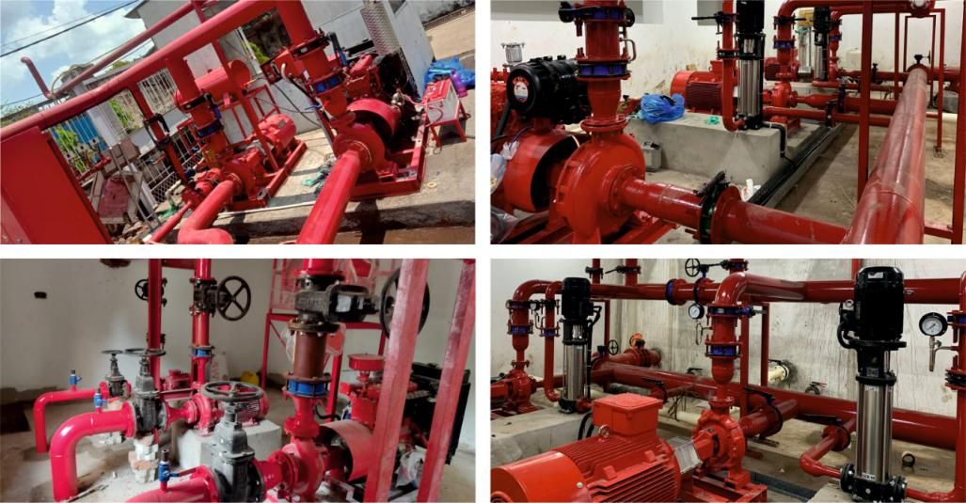
End-Suction Fire Pumps Installations

Slide 31
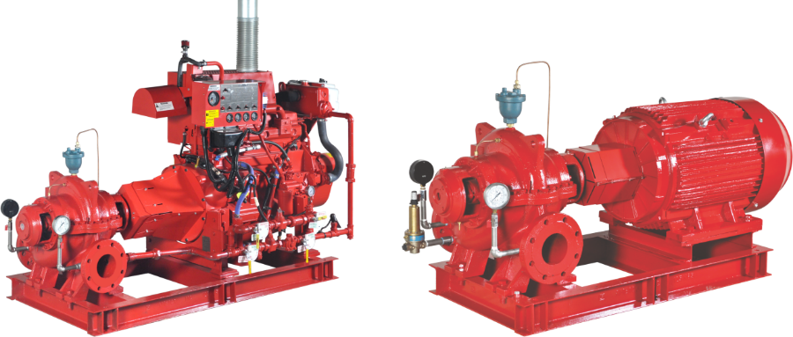
Horizontal Split Case Fire Pumps
Technical Data
• Flow Range : 1700 lpm. to 11350 lpm.
• Pressure Rang :43 mtr. to 224 mtr.
• Diesel Engine & Electric Motor driven
• UL Listed, FM Approved, NFPA-20 design
• Factory Assembled & Factory tested

Slide 32
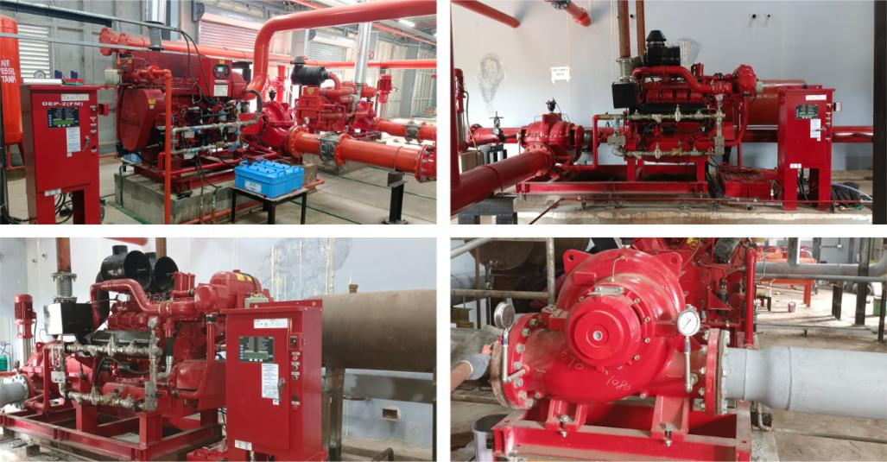
Horizontal Split Case Fire Pumps Installations

Slide 33
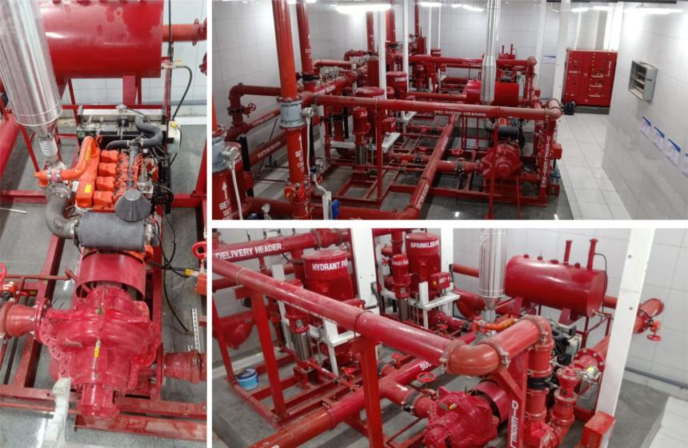
Horizontal Split Case Fire Pumps Installations

Slide 34
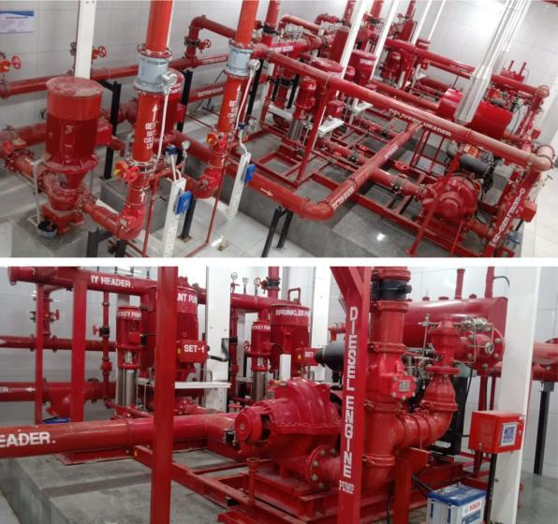
Horizontal Split Case Fire Pumps Installations

Slide 35
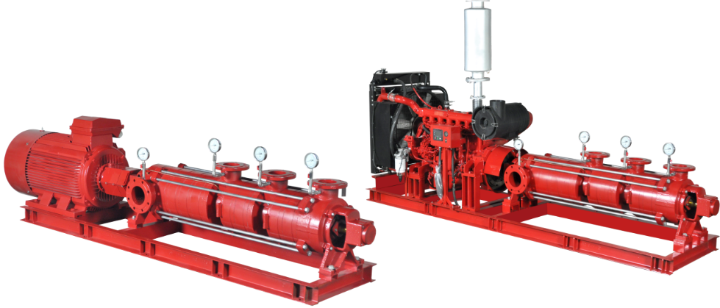
Multi stage Multi outlet Fire pumps
Technical Data
• Flow Range : Upto 6500 lpm.
• Head Range : Upto 450 m.
• Diesel Engine & Electric Motor driven
• Maximum Number of outlet : 7
• NFPA-20 design
• Factory Assembled & Factory tested

Slide 36
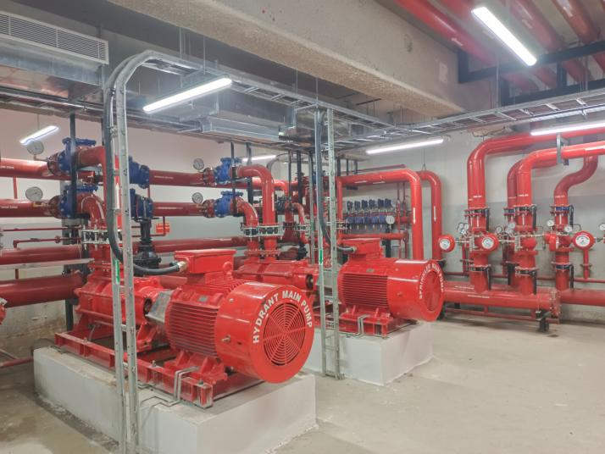
Multi stage Multi outlet Fire pumps Installations

Slide 37
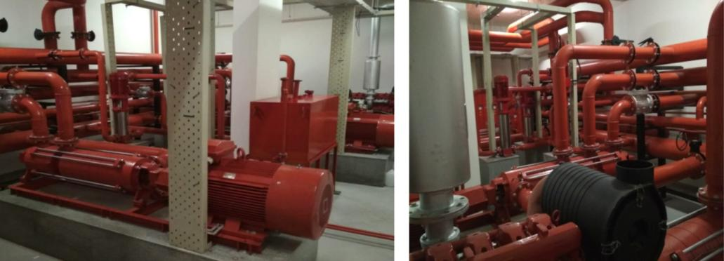
Multi stage Multi outlet Fire pumps Installations

Slide 38
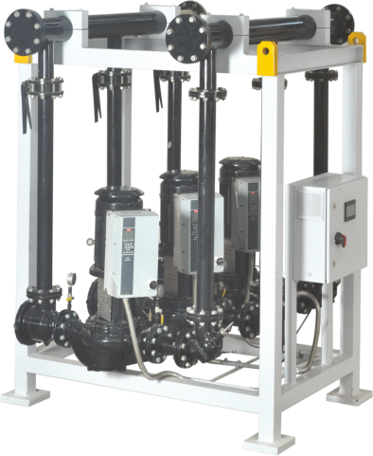
HVAC Packaged Pumping Systems
• Available with Close Coupled End Suction and Vertical Inline Pumps.
• Complete System pre-plumbed with valves, piping and controls.
• Quality factory fabrication of piping using CNC plasma
cutting and welding machines.
• Factory assembled and tested.
• Quick installation at site.
Application :
• Water Supply
• Pressure Boosting Systems
• HVAC Cooling & Heating Systems
• Industrial Systems etc.

Slide 39
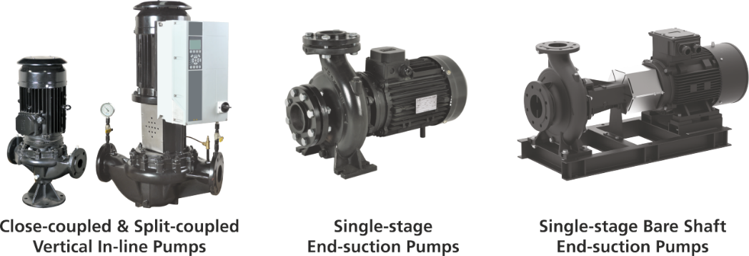
Types of Chilled Water Pump
Features:
• CED coated rust resistant finish
• Dynamically balanced impeller
• PN 16 as standard
• Mechanical shaft seal.

Slide 40
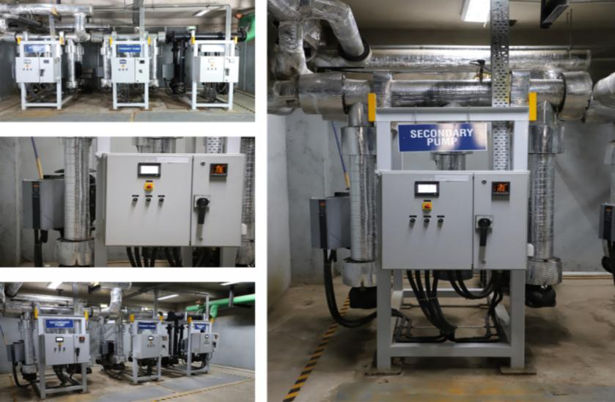
HVAC Installations

Slide 41
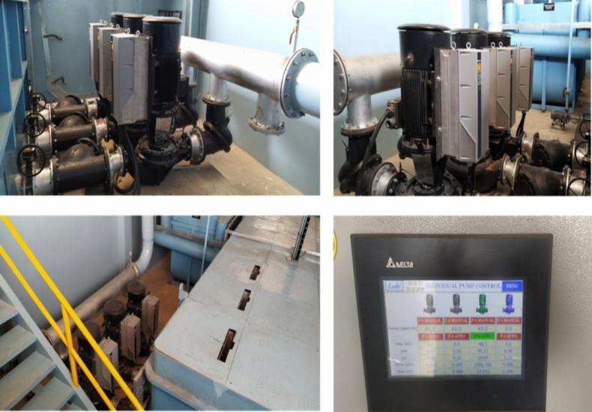
HVAC Installations

Slide 42
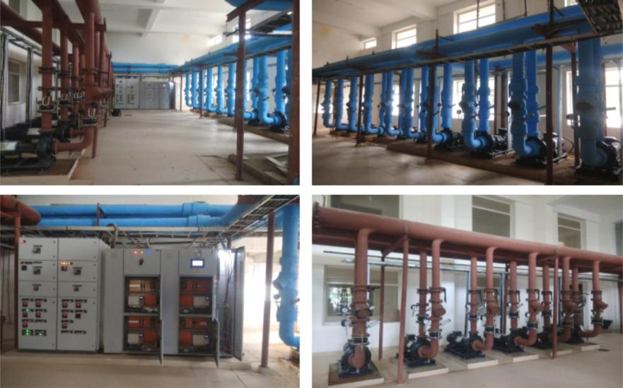
HVAC Installations

Slide 43
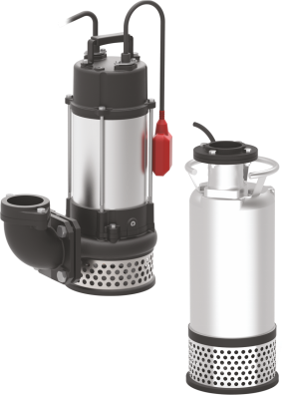
Drainage Pumps
Head : Upto 47 meter
Flow : Upto 156 m3/hr
HP : Upto 30
• Available in both Single & Three phase
• MOC : CI Casing & Impeller, SS Motor Casing
• Thermal Overload Protection , IP 68, Class F Insulation
• Double Mechanical Seal Sic/Sic/NBR + Carbon/Ceramic/NBR
• Solid Handling up to 11 MM.
• Vortex Impeller
• Permanently lubricated Ball Bearings
Application :
Slushy Water, Wastewater witout solids, Sump Drainage,
Dewatering for Fish Ponds & Basements.

Slide 44
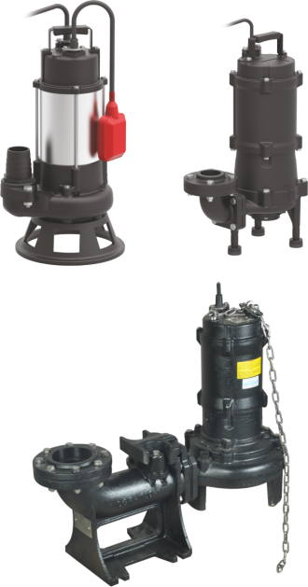
Sewage Pumps
Head : Upto 50 meters
Flow : Upto 1800 m3/hr
HP : Upto 100
• Available in both Single & Three phase
• MOC : Cast Iron Casing & Impeller, SS 304 Motor Casing.
• Thermal Overload Protection ,IP 68, Class F Insulation
• Double Mechanical Seal Sic/Sic/NBR + Carbon/Ceramic/NBR
• Solids Handling up to 35 MM.
• Vortex or Semi open Impeller
• Permanently lubricated Ball Bearings
Application :
Sewage from Buildings, Hotels and wastewater from
Factories. Emptying Septic tanks, cesspits and sewage
pumping stations. Wastewater with solids, Sump Drainage,
Dewatering for various systems.

Slide 45
Sewage & Drainage Installations

Slide 46
LUBI INDUSTRIES LLP
Lubi Corporate Campus - Near Tragad Under Pass, S.P. Ring Road, Tragad, Ahmedabad - 382 421. Gujarat, India.
Phone : +91 - 79 - 61700100 • indsales@lubipumps.com • www.lubipumps.com

